Slide 1
Course Title: Engineering Chemistry-1
Course Code: CHE109
(Chapter 12)
Dr. Joyanta Kumar Saha
Associate Professor
Department of Chemistry
Jagannath University

Slide 2
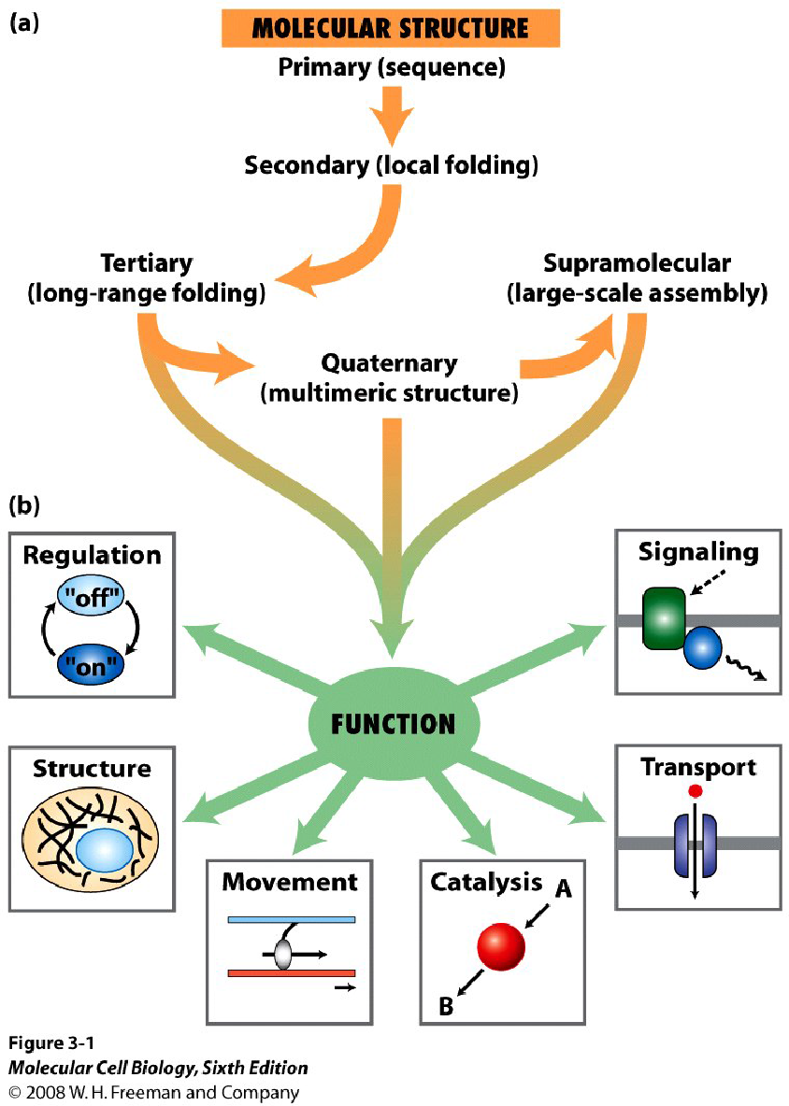
Protein
Proteins perform multiple functions in a cell and they are the factors to control several events. They are the building blocks and work as enzyme to participate in metabolic reactions of the organism. Proteins are the result of polymerization of L-α-amino acids by peptide bonding. This, however, is also true for any polypeptide or small peptide.
Understanding functional architecture gives us POWER to:
•Diagnose and find reasons for diseases
•Create modifying drugs
•Engineer our own designer proteins

Slide 3
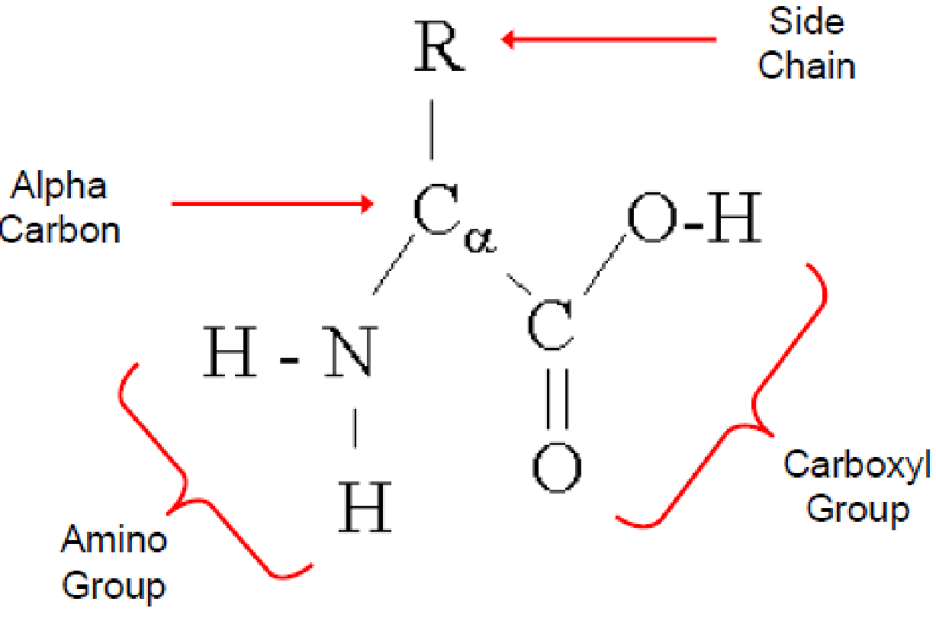
Amino Acids: proteins are made up of amino acids joined by peptide bonds. Each protein can be broken into the constituents amino acids by a variety of methods to study the free amino acids. Twenty different amino acids are found in protein. The first amino acid discovered was asparagines in 1806. The name of amino acids were trivial or classical or in few cases derived from the food source from which they were isolated first. For examples; Asparagine was isolated from asparagus, glutamate from wheat gluten, tyrosine from cheese (greek tyros, cheese) and glycine has derived its name due to sweet taste (greek Glycos; sweet).

Slide 4
Amino acids share common structure:
All 20 amino acids are α-amino acids with a common structure. Each amino acid has a carboxyl group and amine group attached to the primary carbon (the α-carbon).
They differ from each other in terms of side chain or R group. The side chain varies in structure, chemical nature and that has influence on the over all property of amino acid.
Except Glycine, each carbon is attached to the four different groups; making it a chiral center to give stereoisomers. There are two common forms of stereoisomers called as enantiomers found in the amino acids. These are non-superimposable mirror images to each other, for example, L and D-alanine.
Amino acid names are often abbreviated as either three letters or single letters.
The amino acid sidechains in a peptide can become modified, extending the functional repertoire of amino acids to more than hundred different amino acids.
A protein’s amino acid sequence determines its three-dimensional structure (conformation). In turn, a protein’s structure determines the function of that protein

Slide 5
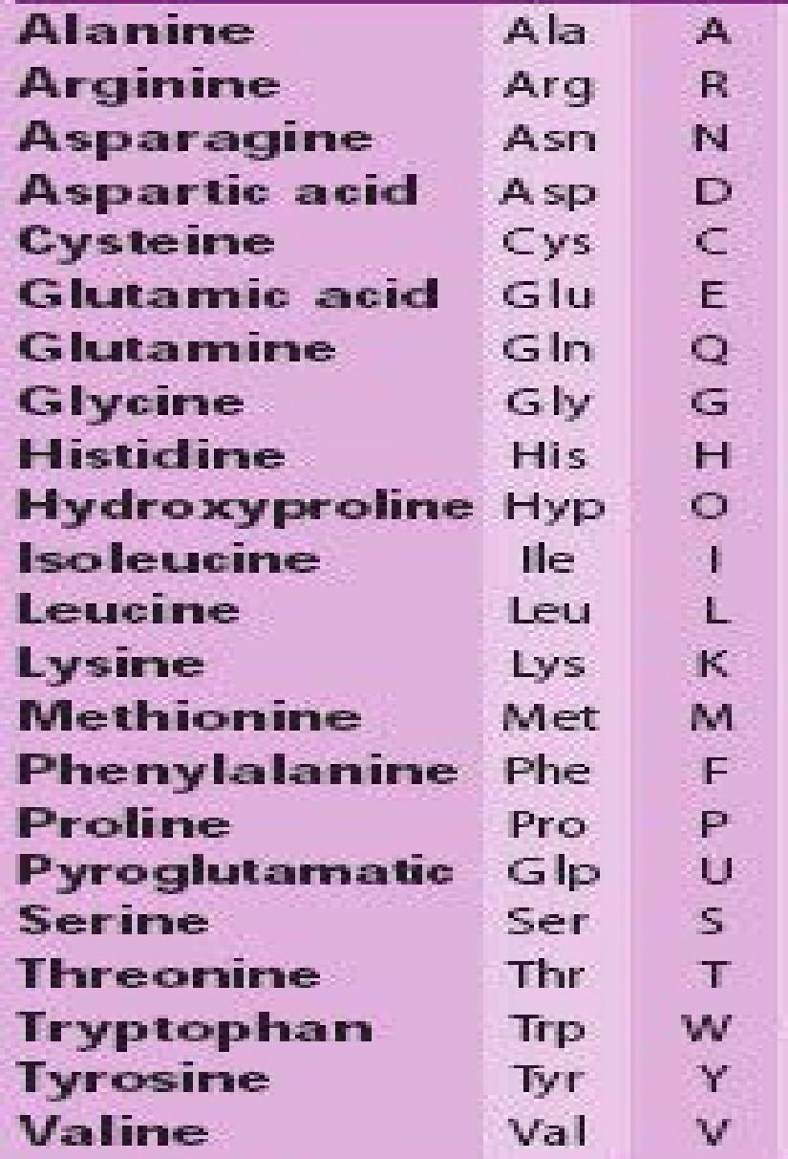
Amino acids are classified by R groups: As discussed, different amino acids are classified based on the side chain or R group. All these 20 amino acids are denoted by first letter (3 or single) or other letter (3 or single).

Slide 6
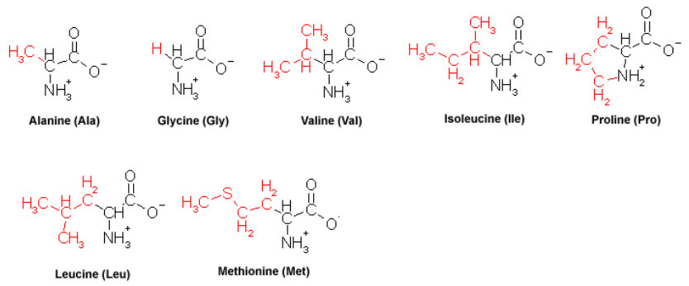
NONPOLAR, Aliphatic R Group: The R group in this amino acids are non-polar and hydrophobic. Examples include are alanine, valine, leucine, isoleucine and glycine, methionine, proline.

Slide 7
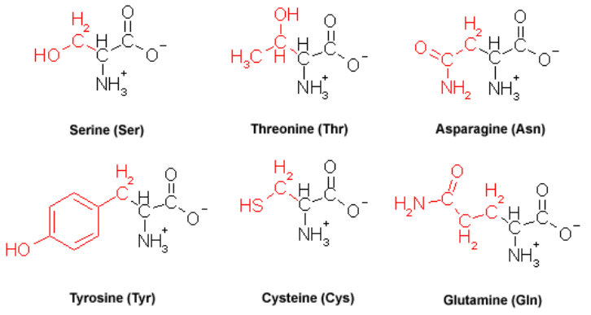
POLAR, Uncharged R Groups: The R group in this amino acids are uncharged and they are more polar than hydrophobic amino acids. Examples include are serine, threonine, cysteine, asparagines and glutamine.

Slide 8
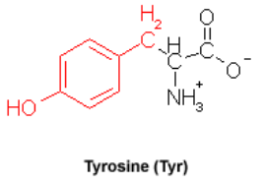
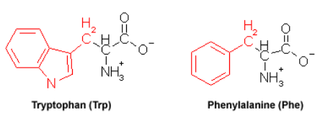
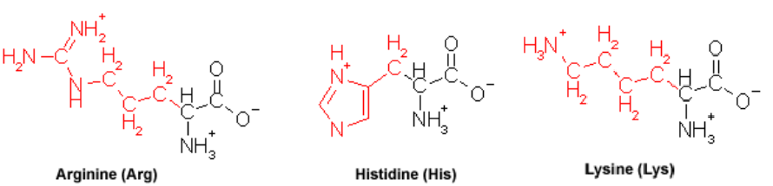
AROMATIC R Groups: The R group in this amino acids are hydrophobic side chain. Examples include are Phenylalanine, tyrosine and tryptophan.
POSITVELY Charged (Basic) R Groups: The R group in this amino acids are acidic with net positive charge. Examples include are Arginine and Lysine.

Slide 9
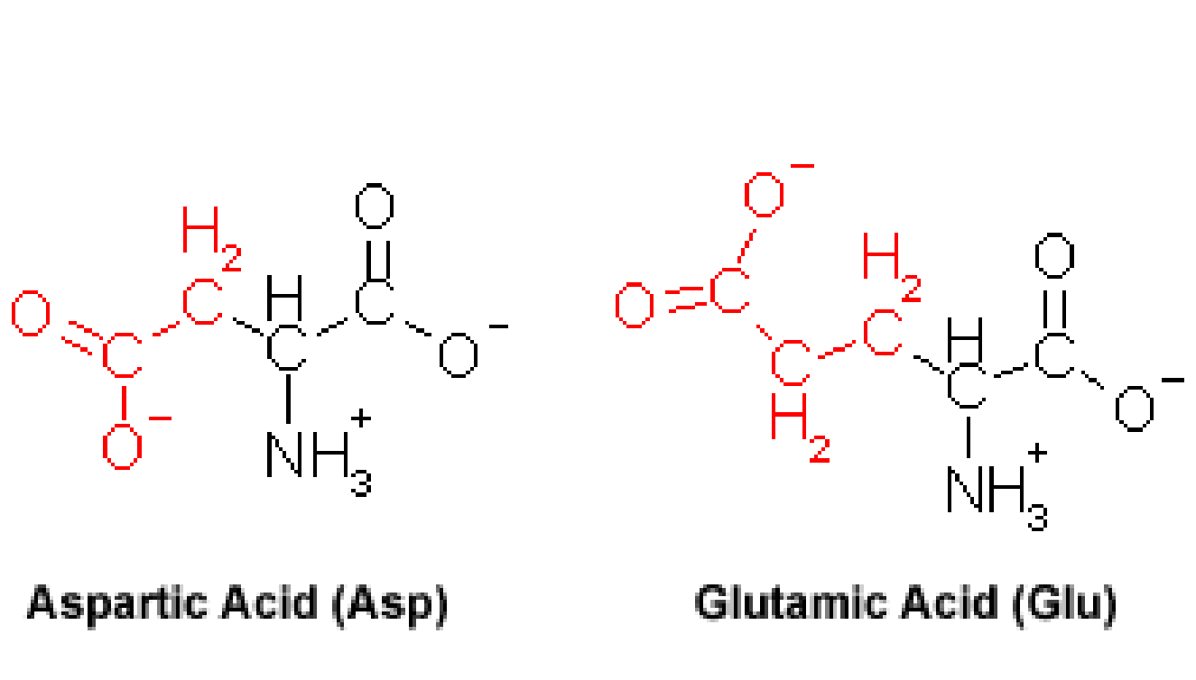
NEGATIVELY Charged (Acidic), R Groups: The R group in this amino acids are basic with net negative charge. Examples include are aspartate and glutamate.

Slide 10
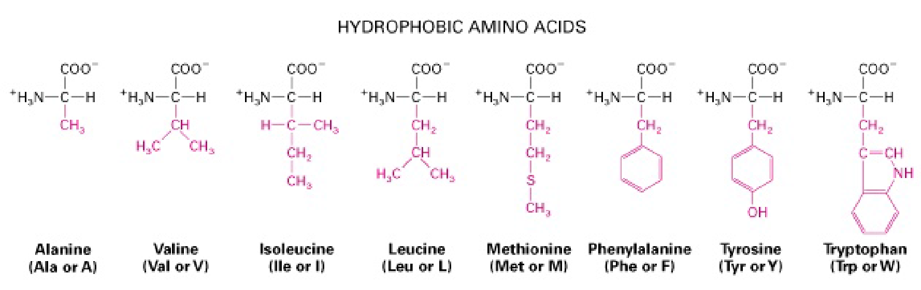
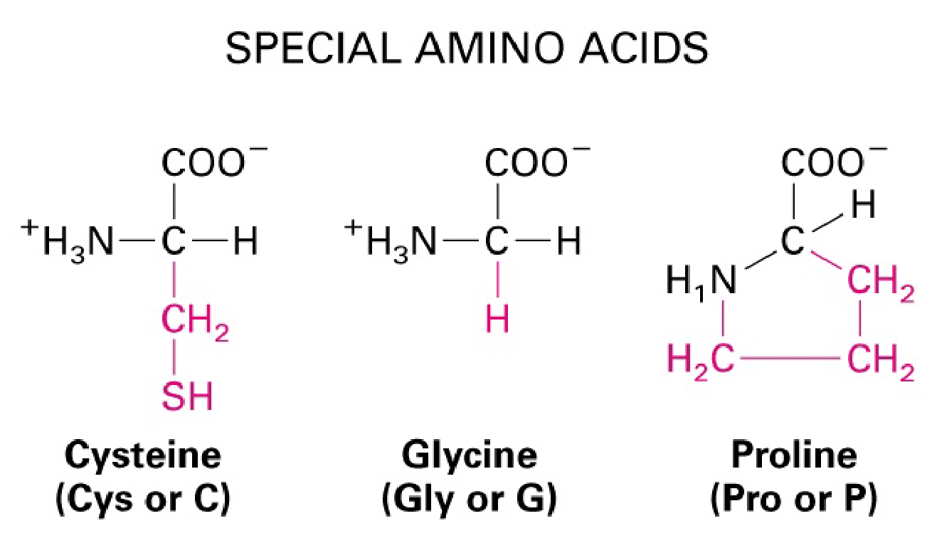
R: Hydrophilic: Basic, Acidic, Non-charged
Hydrophobic: Special

Slide 11
Essential amino acids are the amino acids which you need through your diet because your body cannot make them. Whereas non essential amino acids are the amino acids which are not an essential part of your diet because they can be synthesized by your body.
Essential
Histidine
Isoleucine
Leucine
Methionine
Phenyl alanine
Threonine
Tryptophan
Valine
Non essential
Alanine
Arginine
Aspargine
Aspartate
Cystine
Glutamic acid
Glycine
Ornithine
Proline
Serine
Tyrosine

Slide 12
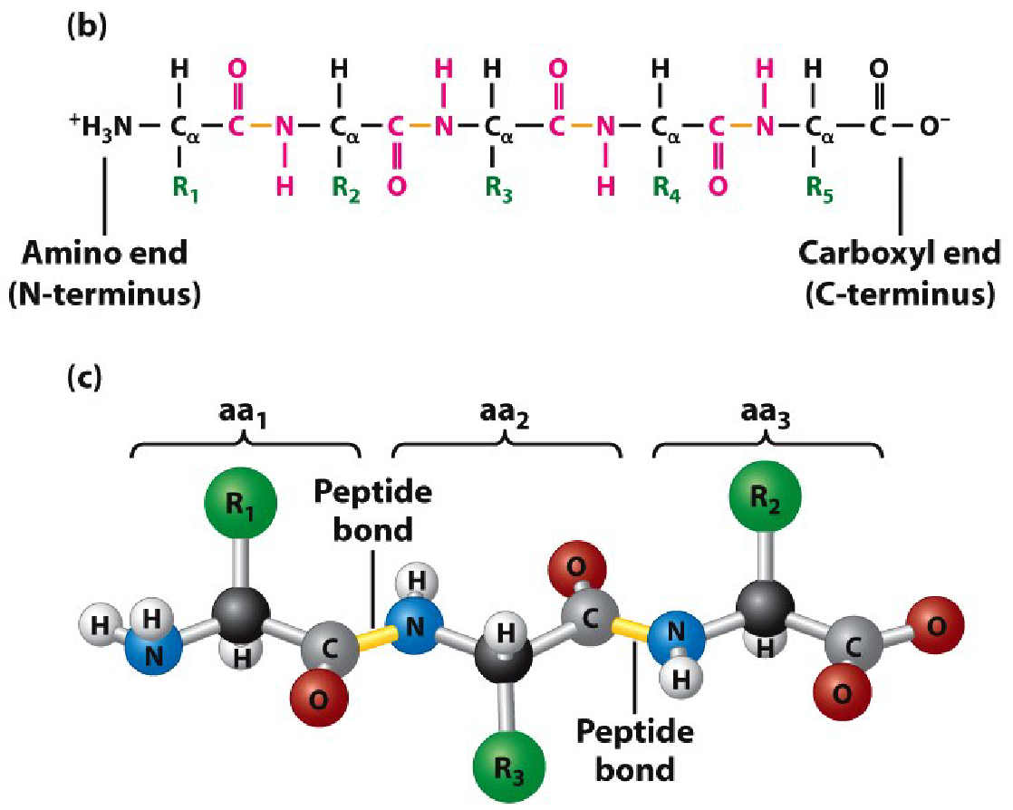
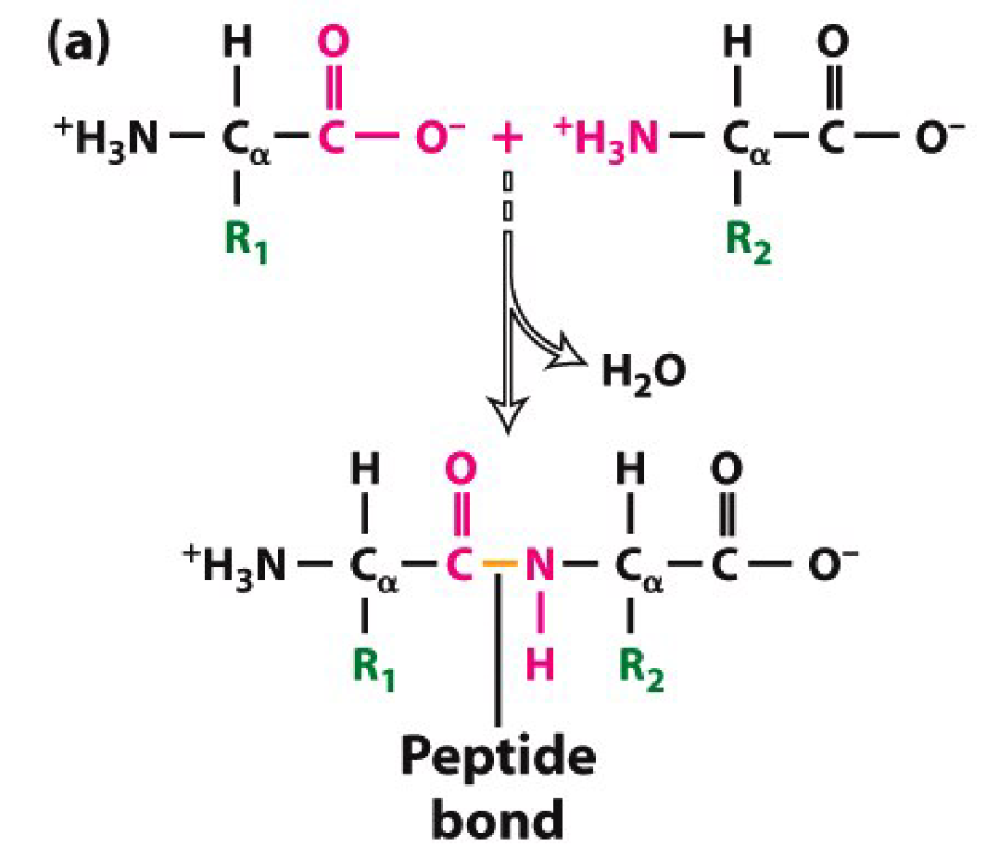
Peptide bonds connect amino acids into linear chains
An amino acid in protein results in the loss of both the amino and acidic groups due to peptide bonding; hence it is no longer called an amino acid but “amino acid residue” instead – or, for simplicity, “residue.”

Slide 13
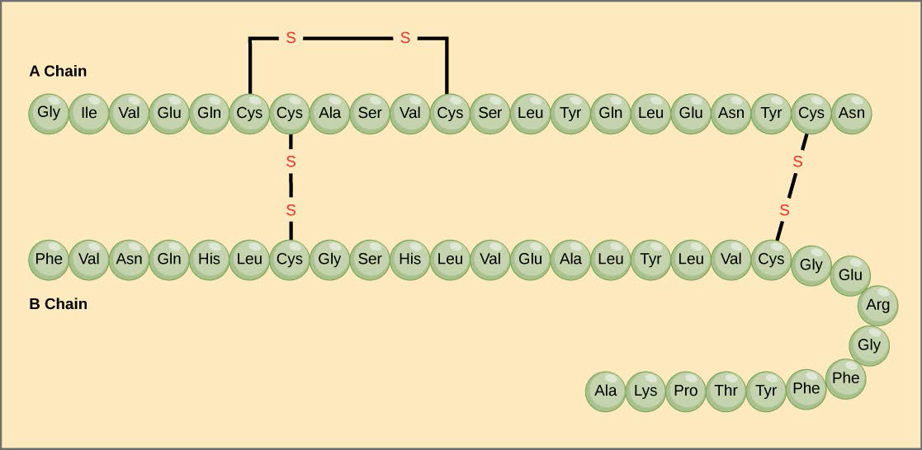
Structural Levels of Proteins
Primary Structure: Linear amino acid sequence in a protein joined together by the peptide bonds defines its primary structure. It can be represented by the one-letter or three-letter codes for amino acids. For example, both M-A-E-D (one-letter code) and Met-Ala-Glu-Asp (three-letter code) describe the same
Stretch of residues in a protein.
The hormone insulin has two polypeptide chains A, and B. The sequence of the A chain, and the sequence of the B chain can be considered as an example for primary structure.

Slide 14
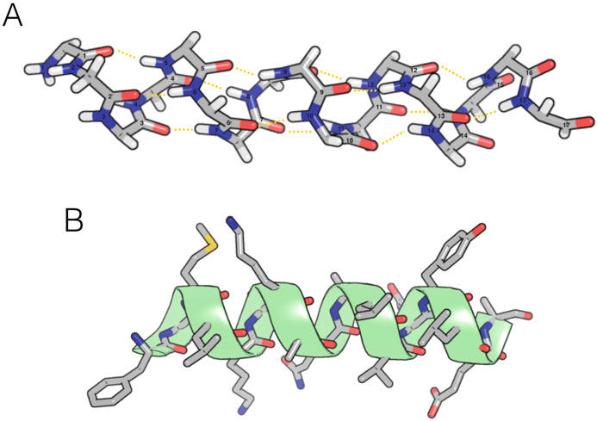
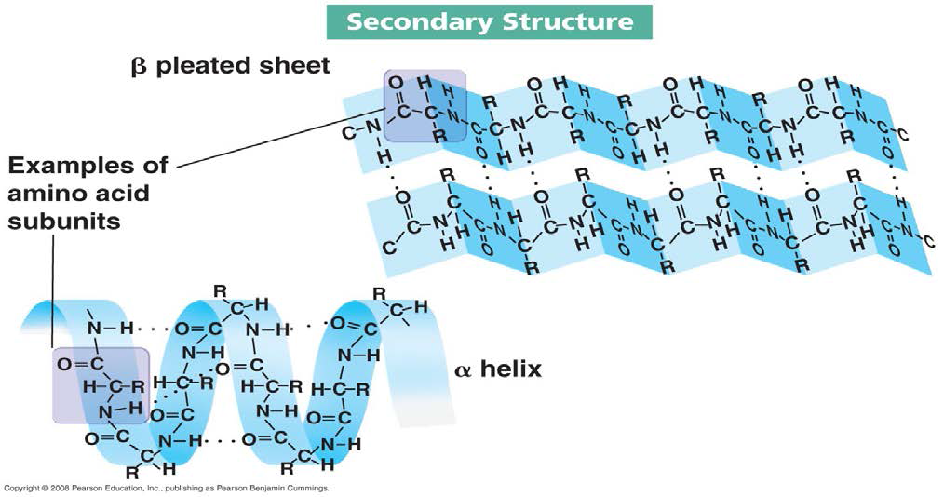
Secondary structure:
• secondary structure, refers to local folded structures that form within a polypeptide due to interactions between atoms.
• The most common types of secondary structures are the α helix and the β pleated sheet. Both structures are held in shape by hydrogen bonds, which form between the carbonyl O of one amino acid and the amino H of another.

Slide 15
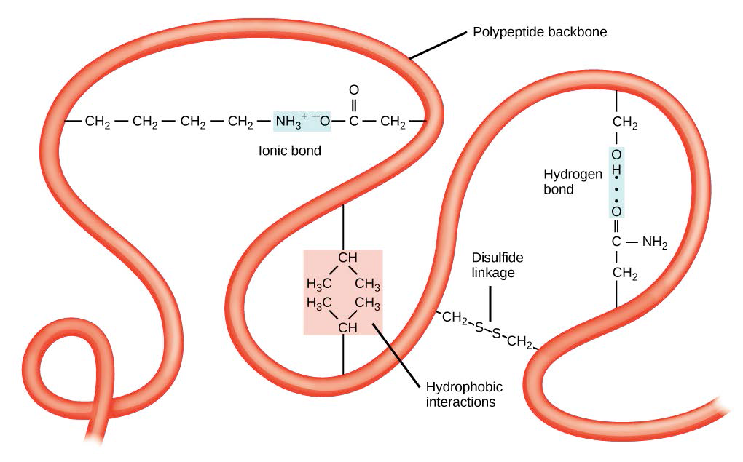
Tertiary Structure:
• The overall three-dimensional structure of a polypeptide is called its tertiary structure. The tertiary structure is primarily due to interactions between the R groups of the amino acids that make up the protein.
• Important to tertiary structure are hydrophobic interactions, in which amino acids with nonpolar, hydrophobic R groups cluster together on the inside of the protein, leaving hydrophilic amino acids on the outside to interact with surrounding water molecules.
•Also, Disulfide bonds, covalent linkages between the sulfur-containing side chains of cysteines, are much stronger than the other types of bonds

Slide 16
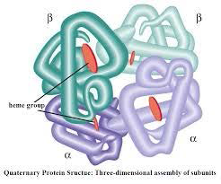
Quaternary structure:
• When multiple polypeptide chain subunits come together, then the protein attains its quaternary structure.
• An example for quaternary structure is hemoglobin. The hemoglobin carries oxygen in the blood and is made up of four subunits, two each of the α and β types.

Slide 17
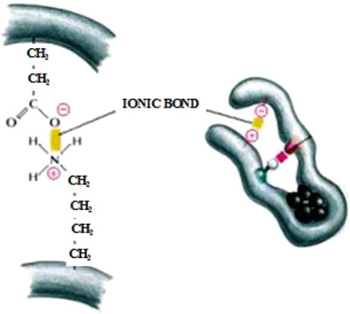
Electrostatic Interactions and Hydrogen Bond: Electrostatic interactions generated by charged surface residues or ionic bonds (salt bridges) play significant role in protein folding (Fig. 2.2). Ionic bonds form the outer layer of hydrophobic core of proteins and are rarely seen in protein interior, and if found at the core, they are strong electrostatic attractions. Electrically charged amino acids, present on surface of protein, help in its suitable folding by interacting with water molecules. Water develops as shield around charged surface residues and helps in stabilizing the protein structure.
Intermolecular ionic bonds

Slide 18
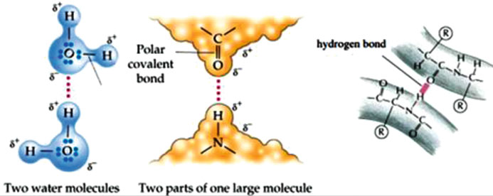
Interaction of hydrogen atom covalently bonded to an electronegative donor atom with another electronegative acceptor atom leads to formation of hydrogen bond, which confers directional interactions strengthening protein folding and structure and its molecular identification. Secondary structure of proteins, α helix and β sheet, makes the core of protein structure.
Intermolecular hydrogen bonds

Slide 19
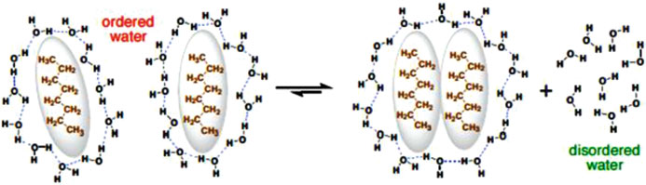
Hydrophobic Bonds: Another chief force activating appropriate protein folding is hydrophobic bonds (Fig. 2.5). They minimize energy loss caused due to interruption of amino acids into water molecule and bring hydrophobic side chains side by side; as a result of which, an interior hydrophobic protein core is developed where maximum hydrophobic side chains are present in close association and protected from interaction with solvent water.
Pro198, Val200 , Leu209 , and Trp207 are major hydrophobic amino acids present in the interior of proteins. Amino acids with hydrophobic side chains are also seen on the polypeptide surface, and when these amino acids are exposed to polar water solvents, they exhibit extensive hydrophobic bonds.
The shape of protein structure is majorly determined by hydrophilic and Hydrophobic side chains of amino acids (Fig. 2.6) and nature of interaction of various R groups with aqueous environment.

Slide 20
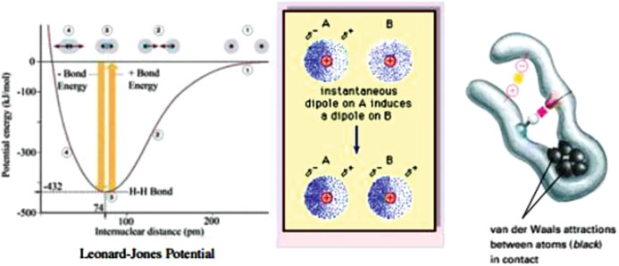
Van der Waals Forces: Weak electrical attraction between two atoms is van der Waals attraction. Fluctuation in electric cloud of each atom yields temporary dipole, and the transient dipole that is generated in one atom induces a complementary dipole on another if they are in close proximity. This leads to weak electrostatic attraction, van der Waals forces. Whenever two atoms are in close proximity, repulsive forces also come into play as a result of negatively charged electrons (caused due to electron cloud overlapping between two adjacent atoms); thus, appropriate distance required for van der Waals depends upon van der Waals radius (size of electron cloud).

Slide 21
Disulfide Bonds: Disulfide bonds, bond between sulfur of cysteine molecules, give higher level stabilization to already existing three-dimensional protein structures, and they are thermodynamically linked to protein folding. According to Anfinsen’s principle, protein sequence is based on oxidative refolding of a protein with disulfide bonds, and it plays vital role in determining protein structure.
Carbohydrates: Carbohydrates are the most abundant biomolecules on the earth. They are essentially hydrates of carbon (i.e. they are composed of carbon and water and have a composition of (CH2O)_{n}. Polyhydroxy aldehyde, keton and their derivates are carbohydrates. Their basic composition:
H-C-OH

Slide 32
Thanks

